Slide 1
Preparing for the Unexpected
Fairfax County Office of Emergency Management (OEM)
Building a Resilient Community

Slide 2
Introductions
Matthew Marquis, Community Engagement Liaison
Matthew.marquis@fairfaxcounty.gov
Fairfax County Office of Emergency Management (OEM)

Slide 3
Agenda
Who are we and what do we do?
Know your local hazards
Resources
Organizing neighborhoods for preparedness, response and recovery
  OEM can help!
  Preparedness goals
  Organizing a neighborhood team structure
  Ongoing involvement with you local OEM- Us!
Q&A

Slide 4
Who are we and what do we do?
Fairfax County Office of Emergency Management (OEM)

Slide 5

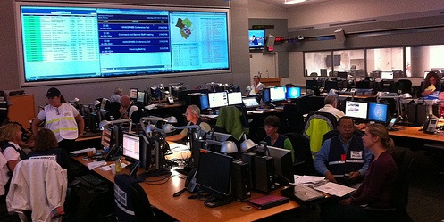
Emergency Management
Coordination, Collaboration, Communication
Fairfax County Emergency Operations Center
Planning
Training & Exercise
Outreach
Grants & Finance

Slide 6
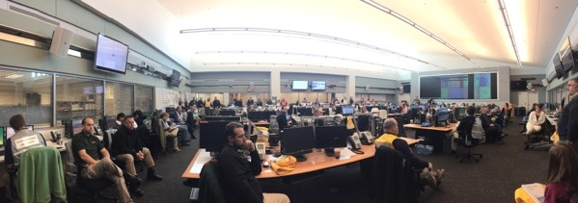
Emergency Operations Center (EOC)
  Activated at various levels of staffing that is dependent on incident requirements
  Coordination and support with local first responders
  Coordination with State and Federal agencies

Slide 7
Know Your Local Hazards
Fairfax County Office of Emergency Management (OEM)

Slide 8








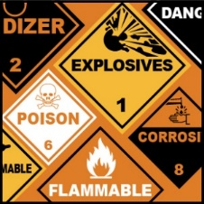







All-Hazards Approach
Prepare for the basics…. “If you are prepared for one,
you’re prepared for all.

Slide 9
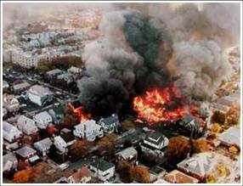
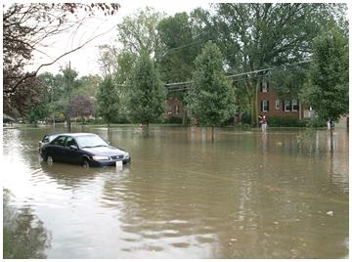
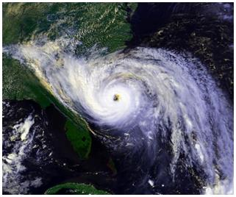
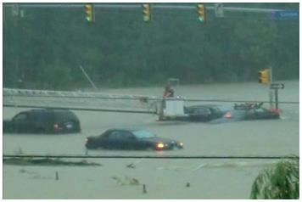
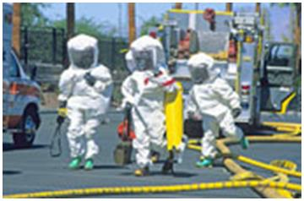
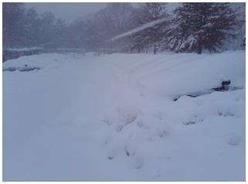
What types of emergencies affect Fairfax County most often?

Slide 10
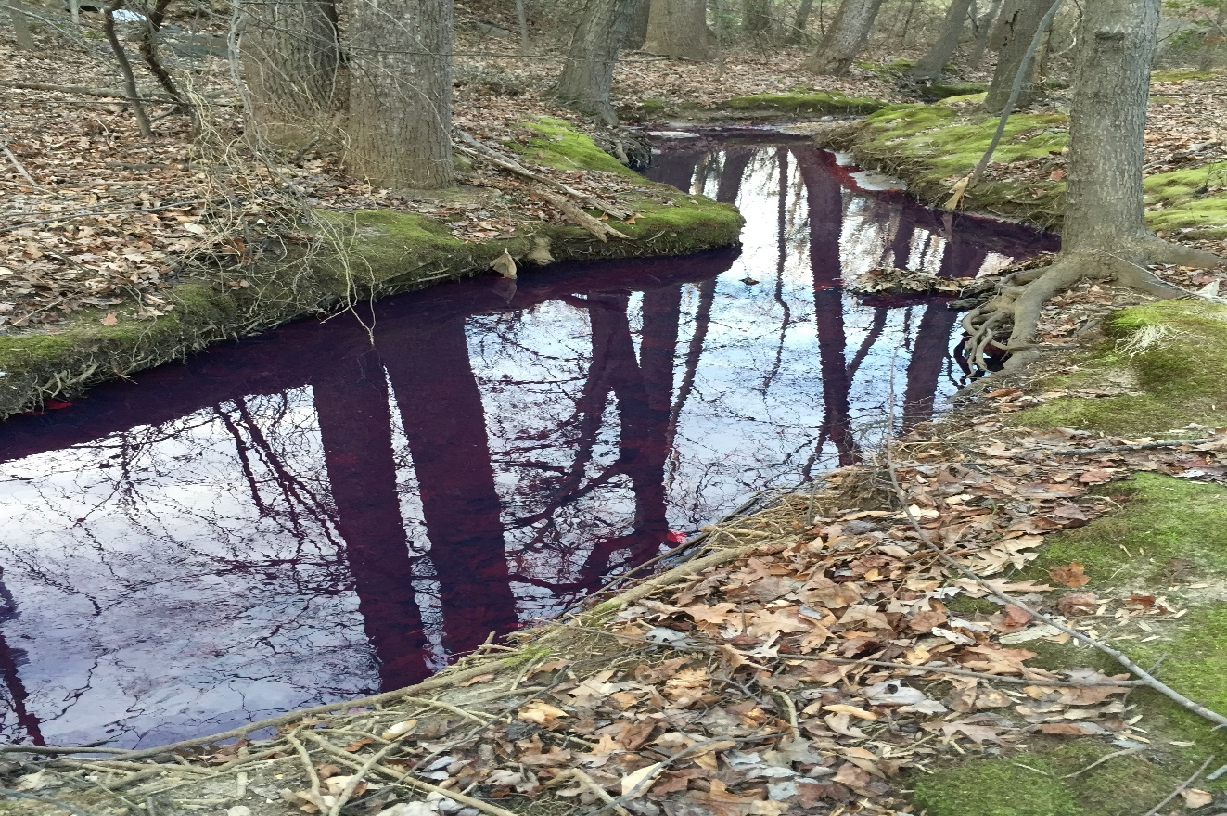
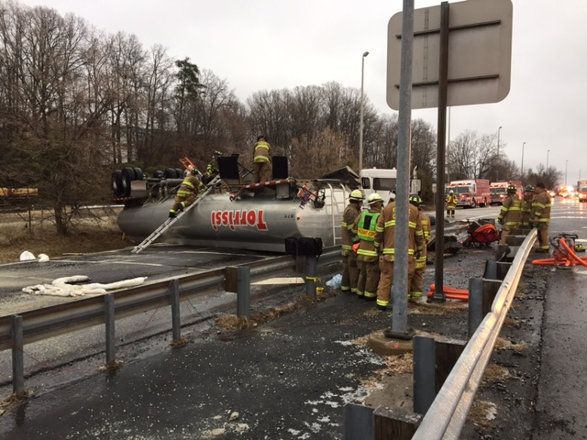
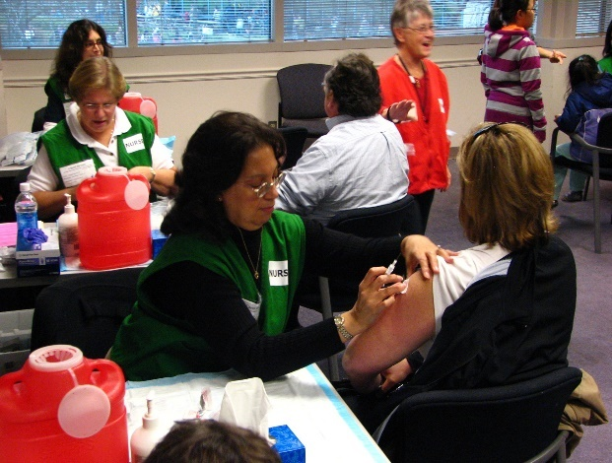
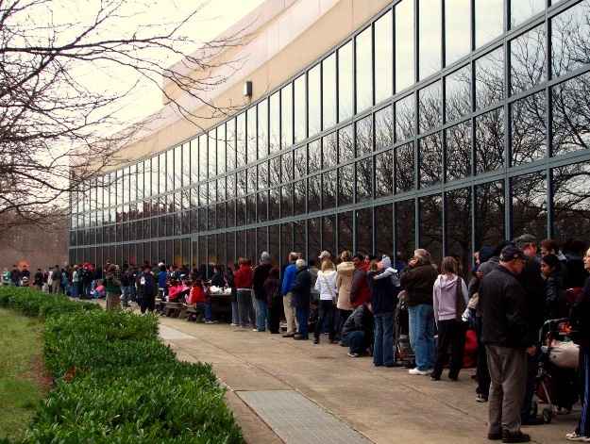
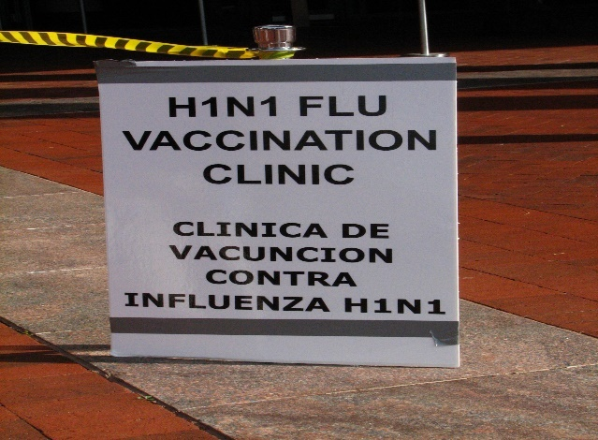
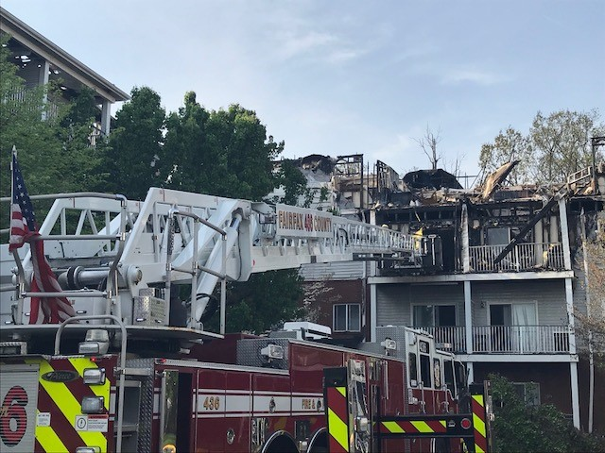
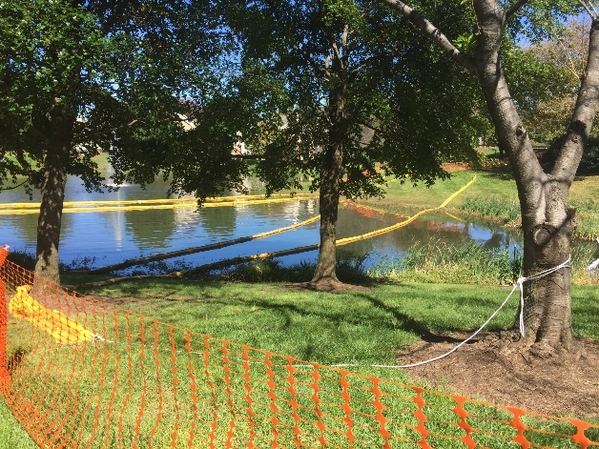
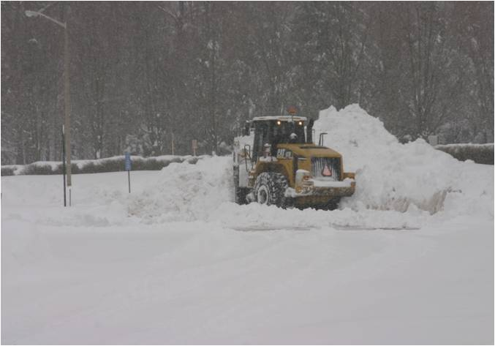
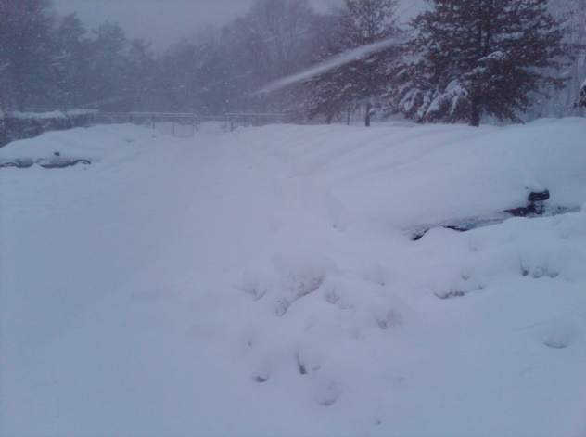
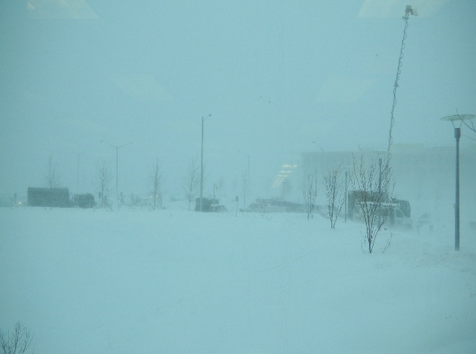
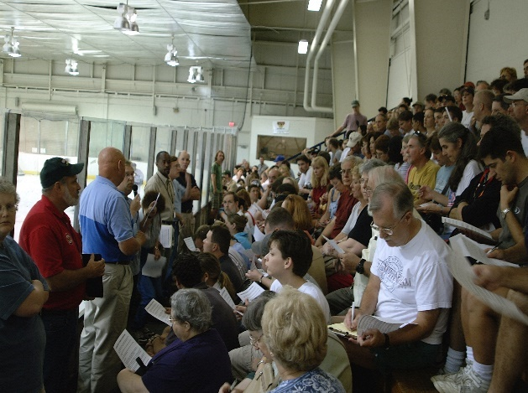
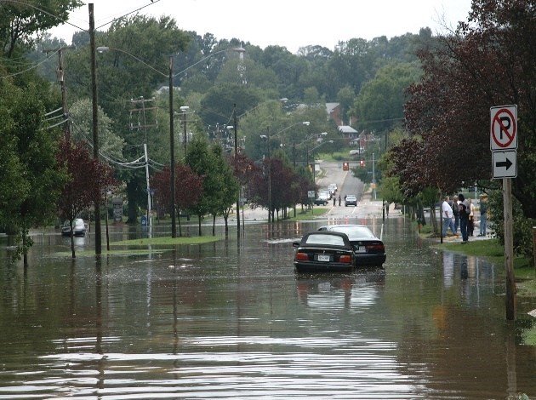
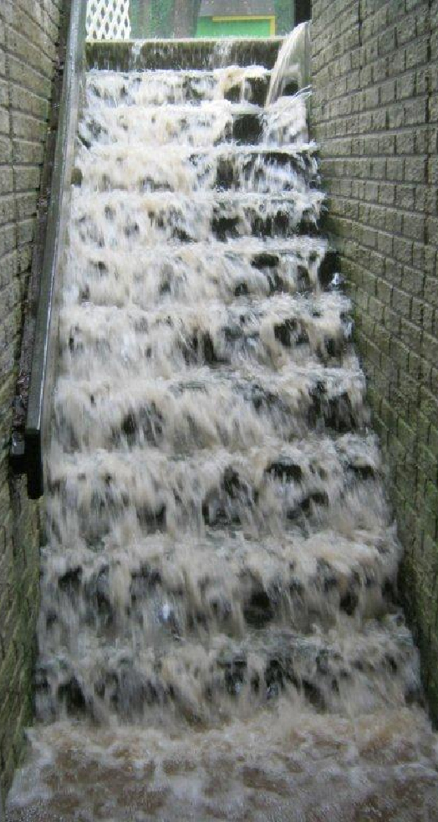
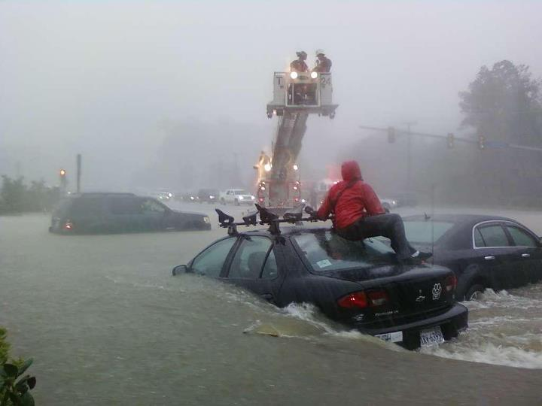
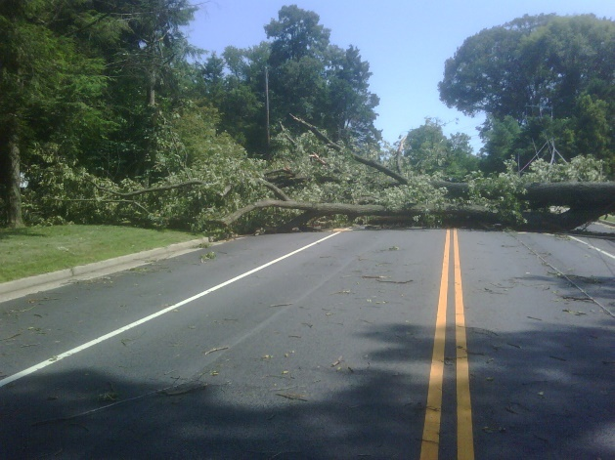
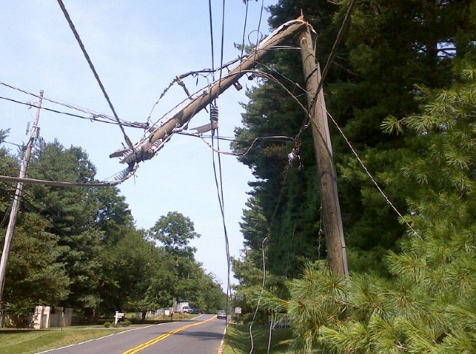
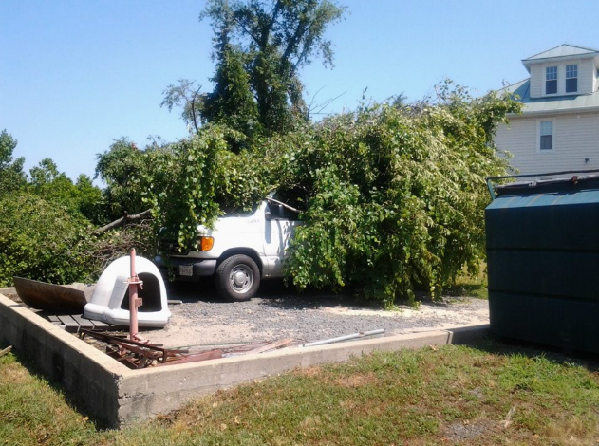
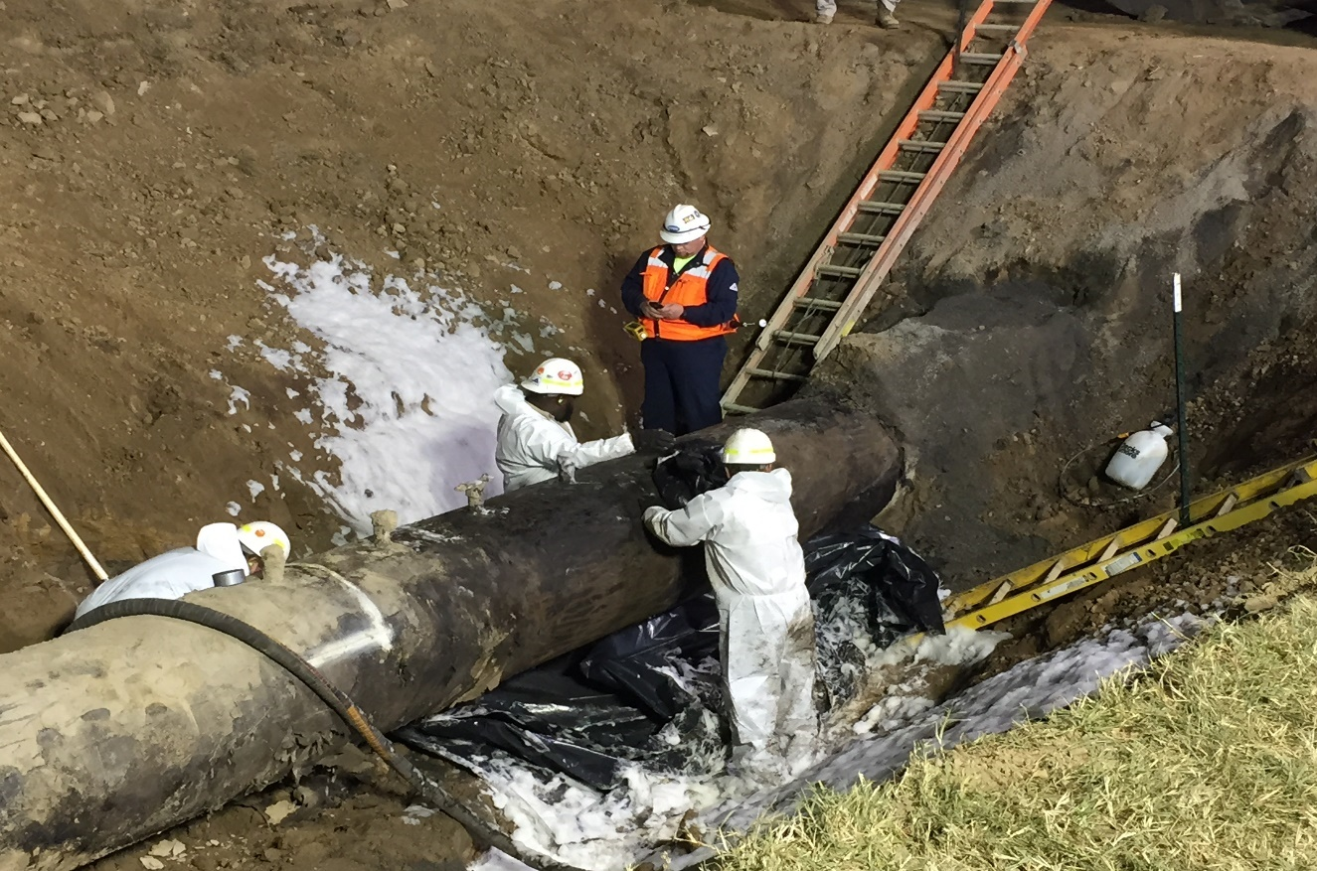
Emergencies that have occurred in Fairfax County and our neighbors
Winter Weather
Flooding
Derecho
HAZMAT
Fire
Pandemic
Notes:
First 4 Pictures are of Derecho Damage
Flooding
TS LEE
Flooding at Huntington Metro
Huntington Floods
Service Information Center at Mt. Vernon Rec Center
Winter Storm
Outside of PSTOC
Mason District Government Center
Lake Braddock High School Parking Lot
National Guard
HAZMAT
Colonial Pipeline Incident
Booms to collect hazardous materials from Colonial Pipeline
Torrisi 18 wheeler
Diesel Fuel on top of creek (watershed)
Fire
Centreville Fire (Forest Glen Apartments)
Industrial Fire
Car Fire
Pandemic
H1N1 Vaccine Sign
Line at Government Center for vaccines
Vaccines

Slide 11
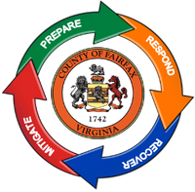
Resilience
Is the capacity of individuals, communities, governments, institutions, businesses, and social systems to survive, adapt, and grow – no matter what kind of challenges or disasters they experience.

Slide 12
Resources?
Fairfax County Office of Emergency Management (OEM)

Slide 13
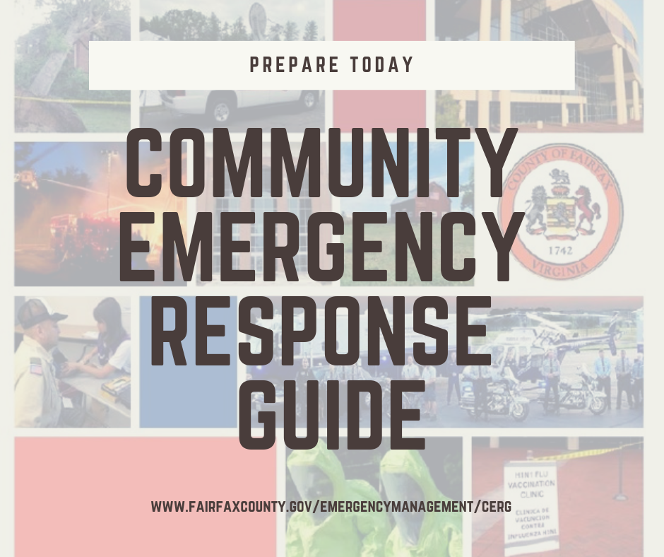

Slide 14
Make sure you and your family are prepared first!
Develop an emergency plan for you and your family
  Communications Plan
  Out-of-Town Contact
  Shelter-in-Place
  Evacuation
  Meeting Places
  Do you know how to turn off your water supply or shut off your gas valve
Develop a kit to fit your needs
  Include basic supplies for your family and pets for 3 DAYS.
  Prepare an emergency kit for your home and vehicle.
  Shelter-in-Place, Evacuation, First Aid

Slide 15

What is the CERG?
Is the complimentary document to the County’s Emergency Operations Plan
  Was written by the OEM with subject matter expertise from:
    Fairfax County Police Department
    Fairfax County Fire and Rescue Department
    Fairfax County Health Department
    Fairfax County Department of Information Technology
This guide is meant to prepare families and businesses to
become more resilient.

Slide 16

What is the CERG? Cont’d
The CERG is a guide that provides the public with tools needed to become more prepared. You’ll be able to create:
  A Family Emergency Plan
  A Business/Organization Emergency Plan
  A Neighborhood Preparedness Plan
  An emergency supply Kit
Also included:
  Important contact information
  Actions to take before, during, and after the
  likeliest hazards
  How to get involved

Slide 17
Where to find the guide
The guide is available online (http://bit.ly/FFXCERG);
Printed copies of the guide can be found at District Supervisor’s office;
Residents can be stop by the Fairfax County Library to find a copy of the guide in the reference section.

Slide 18
Organizing a neighborhood team structure
Neighborhood Disaster Committee
  Ensure preparedness goals are being met
  Help coordinate skilled/trained members
  Host recurring meetings
Establishing teams and their responsibilities
  Job positions description/ duties
    Before
    During
    After
Provide training and a link with local public safety officials

Slide 19
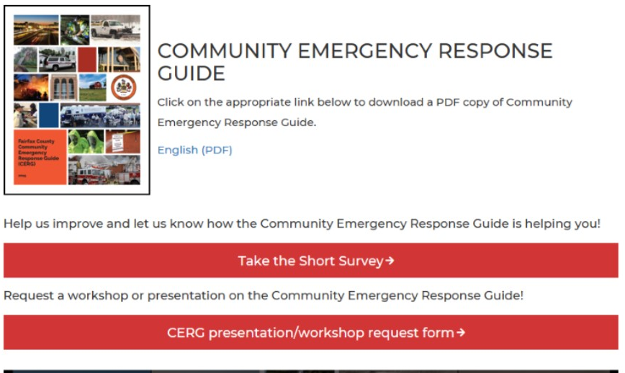
How can you help?
Help us promote the guide download,
presentation/workshop request, and neighbor to neighbor coordination.
Share social media crafted posts and tweets.
Use the talking points we provide in
community presentations, workshops,
print material, blogs, newsletters, and team
meetings.

Slide 20
Stay Informed
Fairfax County Office of Emergency Management (OEM)

Slide 21

Stay Informed
Fairfax Alerts: Fairfaxcounty.gov/alerts
Facebook and Twitter: @ReadyFairfax / @Fairfaxcounty
Facebook Live: @ReadyFairfax
Fairfax County Emergency Management Website: fairfaxcounty.gov/emergencymanagement
Fairfax County Emergency Blog: fairfaxcountyemergency.wordpress.com
Get a NOAA Weather Radio to receive weather warnings directly from the National Weather Service

Slide 22
Recurring meetings?
Invite OEM staff to talk about the topic
Develop short-term and long-term preparedness goals
  All households will be prepared for disaster with:
    a personal household plan
    neighborhood disaster training completed (first aid/rescue)
    supplies in place (home & car)
    how to call/text 9-1-1
Your neighborhood will be self sufficient and will have:
  Teams of volunteers for:
    Canvassing – Community Assessment
    Safety and Utilities
    Care of People with Special Needs
    Communications
    Skilled/trained
  Active linkage to local public safety
To accomplish our goals, your neighborhood will involve lots of volunteers…

Slide 23
Upcoming Events and Engagement Opportunities
Fairfax County Office of Emergency Management (OEM)

Slide 24
Events/ Programs
Hurricane Season- June 1- November 30, 2019
Emergency Preparedness Month – September 2019
Community Resiliency Groups (contact: Matthew.Marquis@fairfaxcounty.gov )
Organizations that work together to support each other in disaster and non-disaster times
Network of community partners from varying organizations

Slide 25
Q&A
Fairfax County Office of Emergency Management (OEM)

Slide 26
THANK YOU!
Fairfax County Office of Emergency Management (OEM)

